Slide 1


Disston Academy’s Annual Title One Meeting 2025-26

Slide 2
Welcome!
School: Disston Academy
Date: September 17, 2025
Time: 2:30 PM – 3:00 PM
Location: Media Center
Principal: Etje Ramdohr
2025-26 Annual Title l Meeting
Notes:
Evidence: Upload completed presentation and recorded feedback as part of the evidence to support the Annual Meeting Materials. Do not forget the sign-in sheets, and survey/feedback that you receive throughout the meeting.

Slide 3

Data Resources
Comprehensive Needs Assessment:
Improve in the areas of: Reading Comprehension, Math skill, and testing strategies
School Improvement Plan
Refer to our SIP one pager that you received during orientation.
District Climate Survey (Title l Items)
Our District Climate Survey for the 24/25 school year went well and we are looking to improve this school year.
Notes:
Calling out some data sources to get them started…

Slide 4


All About Title l
Title I is the largest federal assistance program for our nation’s schools.
The program serves 99 schools in Pinellas County including eligible students in 39 non-public schools.
The Title l goal is that every student achieves high levels of academic proficiency.
Notes:
Highlight the Title l Program here in Pinellas County.

Slide 5

Title I Funding Process
2. Florida Department of Education
1. Federal Government
4. Disston Academy
3. Pinellas County Schools
Notes:
The Florida Department of Education receives funds from the federal government. Districts receive Title I funds from Department of Education, and the school district distributes these funds to schools based on the percentage of children eligible for free/reduced price lunch; however, students do not have to be from low-income families to receive help.

Slide 6

Title l Supplemental Resources
Paraprofessional provide academic and behavioral support in classroom and one and one settings
Lunch tutoring
Professional Development for staff
Differentiated text and actives to support ALL students
Notes:
Definition: provided in addition to what is already present or available to complete or enhance it extra academic support and learning opportunities for economically disadvantaged students.

Slide 7
Title I Schoolwide Planning and Input
First
Second
Last
Seek Input from school, family, and community members determine how Title I funds are used based on a needs assessment.
Please attend online or in-person meetings/trainings and complete surveys to provide input on Title I funding.
All Title I schools must document that parents are involved in the schoolwide planning process.
Notes:
Evidence for input – input from school can be a survey or notes, which include quotes related to what was shared as feedback AND how this input will be used to inform the PFEP and future engagement activities.
Evidence of Attendance – please include attendance of DIVERSE stakeholder group/s.

Slide 8

Title I Schoolwide Budget
Disston Academy is provided $21,000.00 for supplemental resources and programs for increased student achievement.
Family Engagement
Supplies (technology)
Professional Development
Staff (Paraprofessional, Parent Community Liaison)

Slide 9
Total Allocation – $21,000.00
Supplemental Hours for Parent Community Liaison - $3,472.88
Family Engagement- $1,547.29
Classroom Materials - $ 605.00
Paraprofessional – 3,808.86
Data Analytics – 16,635

Slide 10

Parent’s Right to Know
As a parent of a student attending a Pinellas County Public School, you have the right to…
Be
Be provided information on your child’s level of achievement on assessments in Reading/Language Arts, Writing, Mathematics, and Science.
Request and receive information on the qualifications of your child’s teacher and supplemental personnel working with your child.
Be
Be notified of non-highly qualified or out-of-field teachers at the school.
Be
Be informed if your child is taught by a non-highly qualified teacher for four or more consecutive weeks.

Slide 11
Working Together for Student Success
School
School Improvement Plan (SIP)
Title
Title I Schoolwide Plan
Parent
Parent and Family Engagement Plan
School
School-Parent-Student Compact
Title l is now included as a part of the School Improvement Plan
Notes:
As a Title I parent you have the right to be involved in the development of the following plans and documents for our school which can be found on our website (insert website) to view as well as in the Parent Station located (insert location here).
Our school’s Title I Parent Station is located (insert location or photo of Title I Parent Station (front office and on the webpage). Please include photo as part of the evidence monitoring.
You will find a copy of our School Improvement Plan, Title I Schoolwide Plan, School’s PFEP, the School District’s PFEP, Parent’s Right to Know Memo, Upcoming Events, Compact, (insert other documents at your station)
School Improvement Plan (SIP)
Parent and Family Engagement Plan
Title I Schoolwide Plan
School-Parent-Student Compact

Slide 12

Parent-School-Student Compact
The purpose of the compact is to foster student achievement. By signing the Parent-School-Student Compact, Disston Academy, teachers, staff, parents and students agree to work together to share the responsibility of helping students meet or exceed state, district and school academic goals.
The Parent-School-Student Compact is updated every year to include parent, student, teacher, and staff input. Parent, student, teacher and staff comments are welcome at any time during the year.
Please review and sign your child’s Compact.
Our goal is to receive 100% signed compacts!
Notes:
At the elementary level, school compacts are used as a progress monitoring tool through the year during parent teacher conferences.

Slide 13
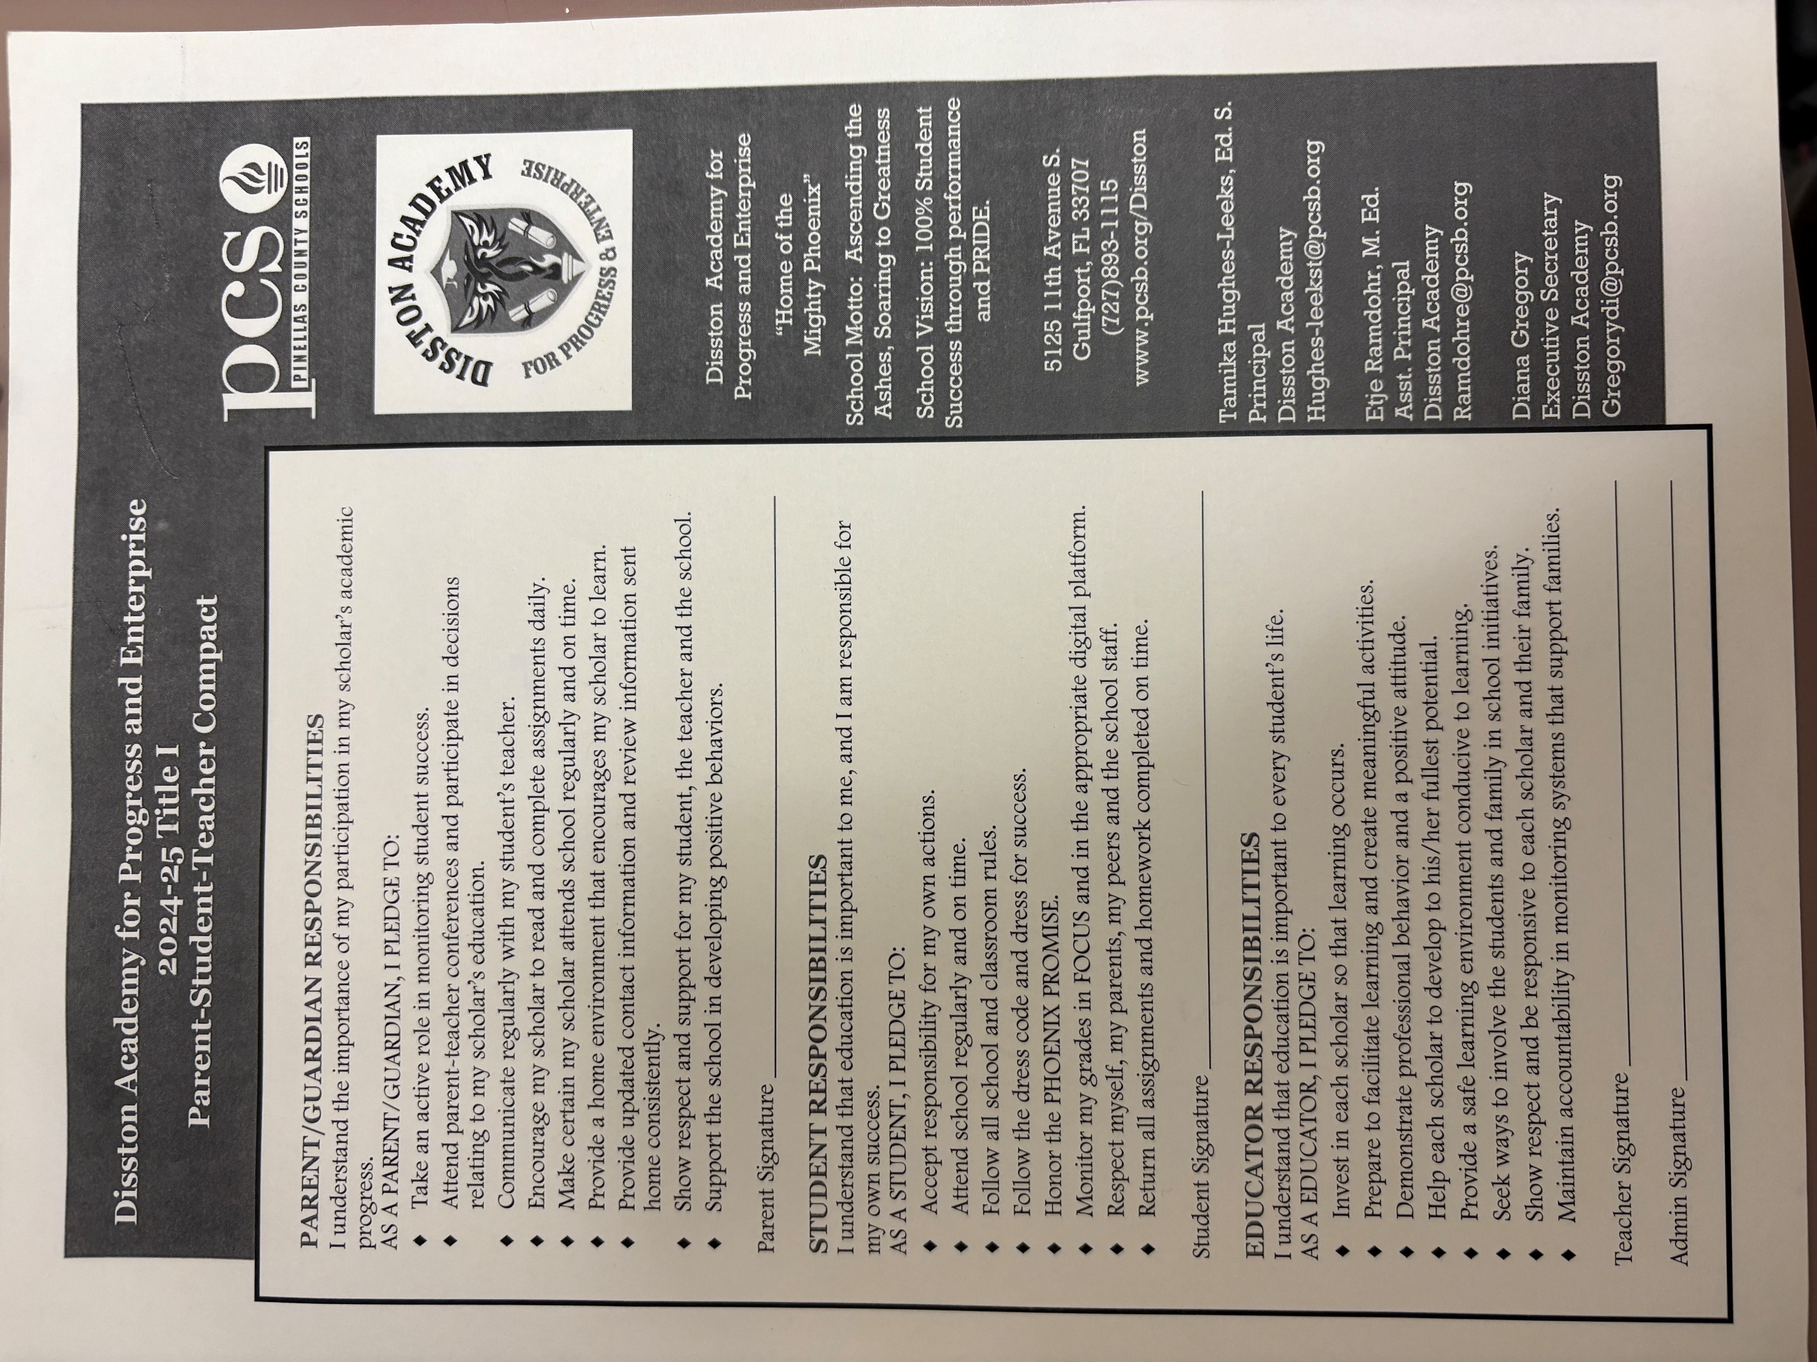
Parent – School- Student Compact
You received the School Compact during orientation. If you need a copy, please let us know.
Notes:
Please insert the an example of your updated school compact. Highlight any things that unique to your school’s compact.

Slide 14

Parent and Family Engagement Plan (PFEP)
The PFEP Sections include information about the following:
Parent trainings to increase student achievement
Staff trainings for engaging parents
Communication methods between home and school
Flexible meeting times
Accessibility for parents
Coordinating with other Federal Programs
To access the full PFEP, please visit
www.pcsb.org/titleone
Notes:
Provide information on the specific committees that parents can be involved. Include the purpose, date and time of meetings.
Explain the PFEP and its purpose.
Consider the evidence related Title I Crate, Sample of Evidence,

Slide 15


Florida Benchmark For Excellent Student Thinking Standards (B.E.S.T). You may read more information by visiting, www.fldoe.org.
Notes:
All curriculum, instruction and assessments are based on student-centered expectations.

Slide 16

School’s Curriculum
Florida Benchmark For Excellent Student Thinking Standards (B.E.S.T). form the framework of everything taught at school.
Reading
Mathematics
Writing
Science
Civics
Notes:
This slide is optional if this will be discussed with classroom teacher
School’s Curriculum
Describe and explain the curriculum (Specific names of texts)

Slide 17
Florida End of Course (EOC) Assessments (Algebra 1, Biology, Civics, U.S. History, Geometry)
To learn more about state assessments visit the Florida Department of Education’s website, fldoe.org/accountability/assessments.
Notes:
This slide is only required, if it applies.

Slide 18

School Report Cards
School Grade and Overview
Population and Enrollment
Assessments – Academic Achievement, Growth, and Population
Assessments – English Language Learners
Graduation and Beyond
Educator Qualifications and Equity
Long-Term Goals and Interim Progress
Accelerated Course Enrollment
Per-Pupil Expenditures
National Data
Available online at https://edudata.fldoe.org/ or Front Office

Slide 19

September 15^{th – 19th} | Start with HELLO week.
September 18th | CLT Testing for juniors and seniors.
September 23rd | CLT Testing freshmen and sophomores.
TBD | Spirit Week
Notes:
Do you have a calendar of key events that are included in your PFEP.
Evidence – Consider this as evidence to include to support Family Engagement.

Slide 20

Parent Advisory Council (PAC)
The District has a Parent and Family Engagement Plan. The summary of the plan is in the Title I School & Family Partnership Overview.
You may access the full plan at www.pcsb.org/titleone
The Parent Advisory Council (PAC) is responsible for reviewing and revising the District PFEP.
PAC will meet virtually or in person with the district’s Title I staff.
Each school is committed to having at least one member representative in PAC.
PAC meets twice a year, if you are interested in representing our school please notify, Nakkia Sly slyn@pcsb.org
Notes:
Please add your PAC representative in slide and share with your Title I Specialist.
https://forms.office.com/r/r5daaMTENE\

Slide 21
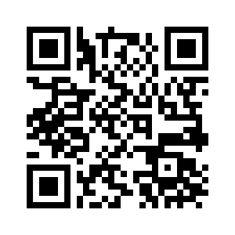
Parent Survey QR Code
Your feedback is greatly appreciated!
Notes:
Please duplicate Microsoft Forms provided or create school survey. To generate a QR code hover over your school’s survey and and right click. Create QR code for this page will be an option.
https://forms.office.com/Pages/ShareFormPage.aspx?id=BZM8c9c5GkaGb_3ye_PH_x-1YNVO6C1FkgA88U6PR2tUNEQzTU0wNkZXVUxVTlpEMU81NkJFMlJNTi4u&sharetoken=FXXhmgwFjSnl0sNz61ki

Slide 22
Any Questions?
Nakkia Sly @ slyn@pcsb.org

